Slide 1
Portfolio Optimization During Market Disruptions:
Are ETFs better than Stocks?
UMBC’s Spring 2022 DATA690: Financial Data Science Presentation
Sean Reidy & Lee Whieldon
Under the guidance of Professor Abdullah Karasan
Notes:
Speaker: Lee

Slide 2
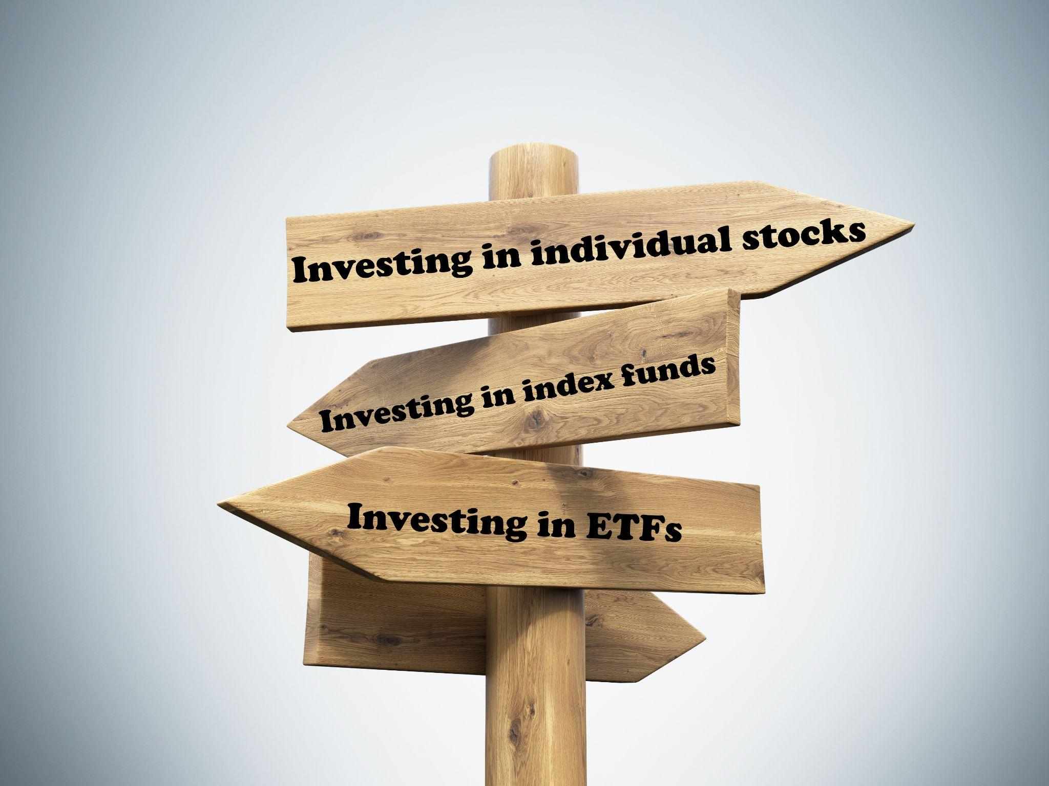
Purpose
Do ETFs (Exchange Traded Funds) provide a more optimized & diversified portfolio when compared to a collection of top stocks traded on the Nasdaq & NYSE during moments of market disruption?
Notes:
Speaker: Lee

Slide 3
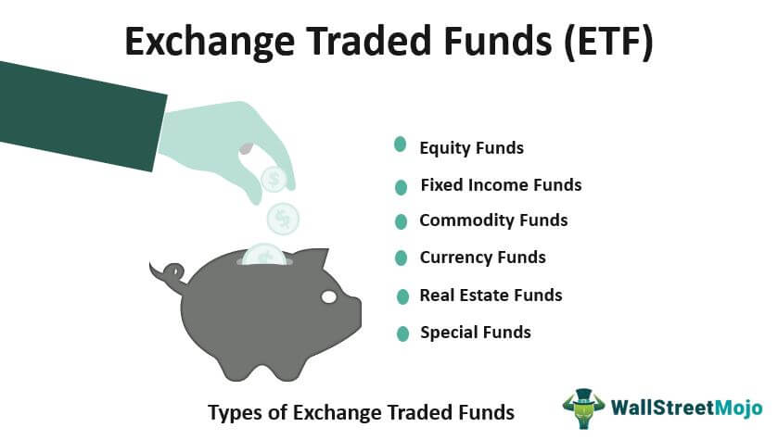
What is an ETF?
“An Exchange Traded Fund is a collection, or "basket", of individual stocks, bonds, or other investments, all pooled together. When you buy a share of an ETF, you own a fraction of that pool of investments.”
https://us.etrade.com/knowledge/library/etfs/stocks-vs-etfs
Notes:
Speaker: Sean
An ETF is a collection or “basket” of individual stocks, bonds, or other investments , all pooled together into a single asset type. When a person elects to invest a in a share of an ETF, they will own a fraction of that pool of investments. ETFs are provided by corporations including Blackrock and Vanguard.

Slide 4
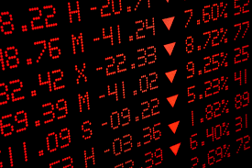
What is a Market Disruption?
“Any situation where the market ceases to function in a normal manner, including physical disruptions (natural disasters) or crashes.”
-https://online.hbs.edu/blog/post/new-market-disruption
Notes:
Speaker: Sean

Slide 5
Market Disruptions Included in Our Project
2015–16 Stock Market Selloff: 6/1/2015 - 6/30/2016
Subprime loan/Financial Crisis: 12/27/2007 - 6/30/2009*
COVID Pandemic: 2/20/2020-2/1/2022**
*Dates selected are based on when U.S. unemployment rate peaked
**Using the last full month end close for our analysis
Notes:
Speaker: Lee

Slide 6

Research Question
Do ETFs (Exchange Traded Funds) provide a more optimized & diversified portfolio based on month end returns when compared to collection of top Nasdaq & NYSE stocks during moments of market disruption?
Notes:
Speaker: Lee

Slide 7
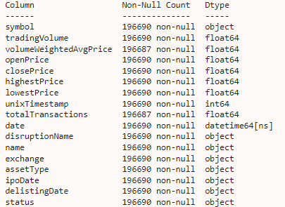
Datasets
AlphaVantage
Asset Types
Polygon.io API
Historical Data - For Cohorts Collection
Yfinance
Historical Data - For EDA & portfolio optimization exercise
Data Overview:
Stock & ETF close price market entries from market disruption time periods for NYSE & NASDAQ markets.
Asset Types associated to above record, classifying stocks as ‘Stock’ versus ‘ETF’ respectively.
Notes:
Speaker: Lee

Slide 8
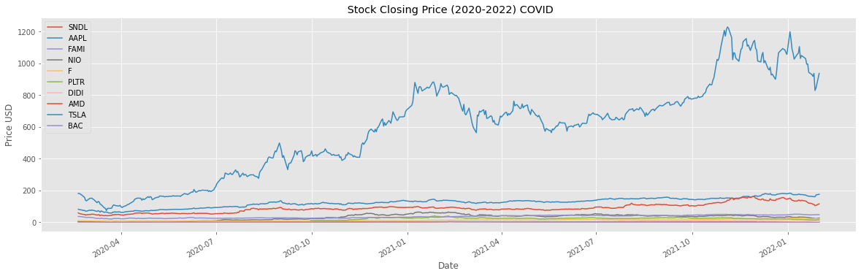
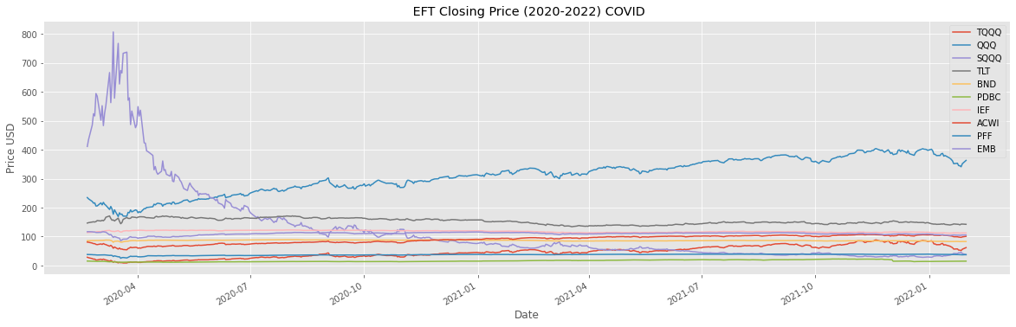
EDA & Approaches
Tesla
Notes:
Speaker: Sean
Whenever working with time series data, visualization is the most effective tool for analyzing trends and patterns in the data. After gathering data on the top performing stocks and ETFs, ranked by average trading volume, we will look at the closing prices and returns of both. First we plot the top 10 stocks and ETFs for each of the three disruption periods (COVID, Selloff, and Subprime Crisis).

Slide 9
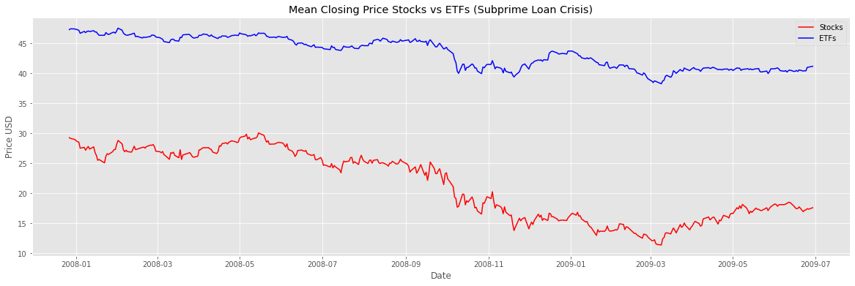
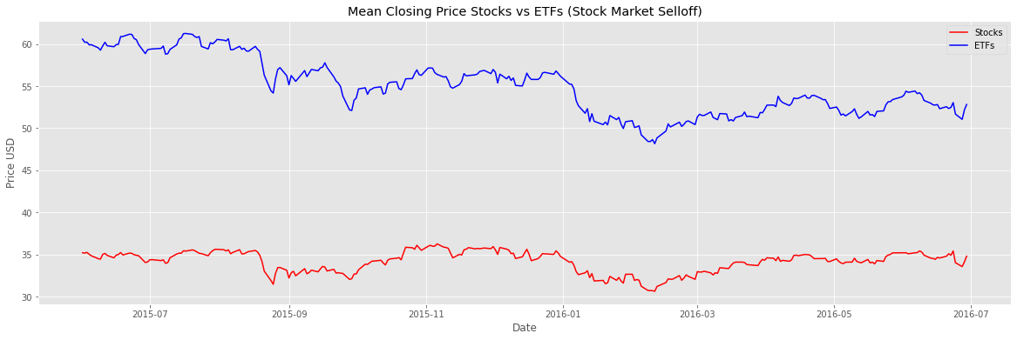
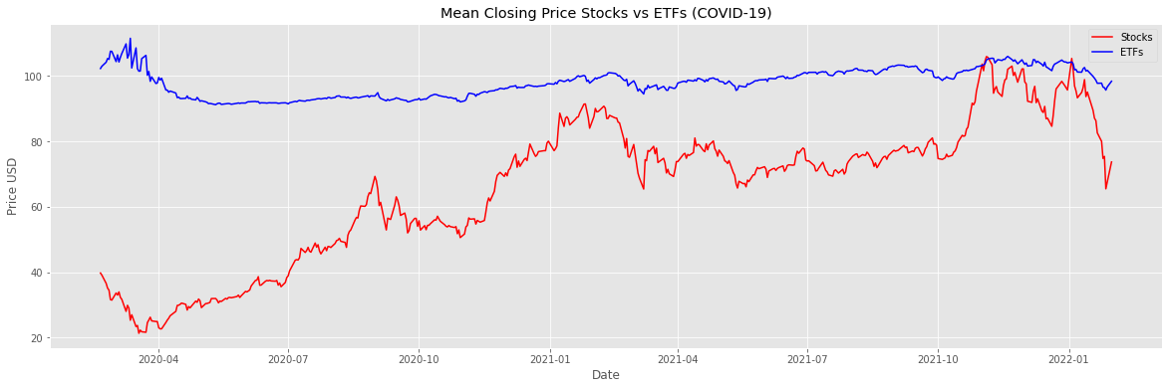
ETFs have a higher mean price and are much less volatile, but does this translate into better returns when compared to stocks?
Notes:
Speaker: Sean
Visually inspecting the closing prices of both stocks and ETFs over all three disruption periods, we can see that ETFs have a higher mean price when compared to stocks. Additionally ETFs appear far less volatile, and more resistant to sudden drops and climbs in the market. In a minor to moderate situation, ETFs outperform individual stocks, when the market expense rapid changes, ETFs advantages are less evident. Expanding upon this, the situational context of the disruption event also influences the difference between stocks and ETFs. For example, during the COVID-19 pandemic, some industry segments were subject to greater losses (hospitality, travel, etc.) and other saw rapid growth (online service, biotech). When market disruptions are evenly felt across every market, such as the subprime loan crisis, ETF’s appear to loose their advantages. We will investigate this further by looking at the returns.

Slide 10
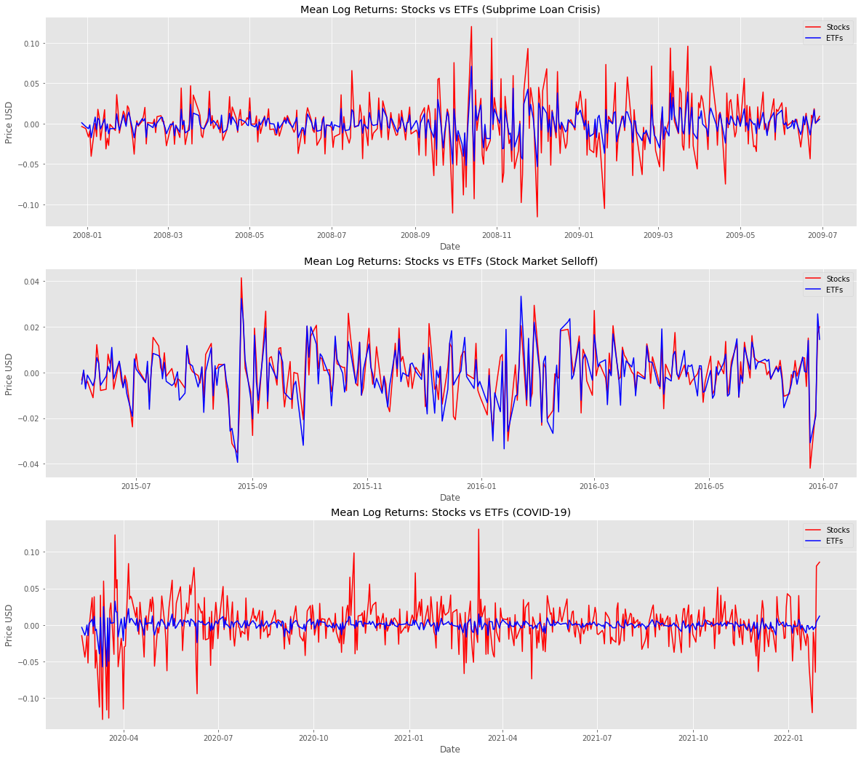
ETFs appear to show less varying levels of returns
Notes:
Speaker: Sean
Key Observations
During COVID-19 ETFs demonstrated a much lower volatility when compared to the other two disruptions. This raises the question if EFTs were managed differently now when compared the other time periods?
In general the returns of EFTs follow similar market patterns at a much lower amplitude compared to stocks
There is indication that each of these three events are unique in the resulting effect they had on both stocks and ETFs.
ETFs are able to “weather the storm” of disruption well, at the cost of lower returns, often completely missing out on periods when the market swings up in value.

Slide 11
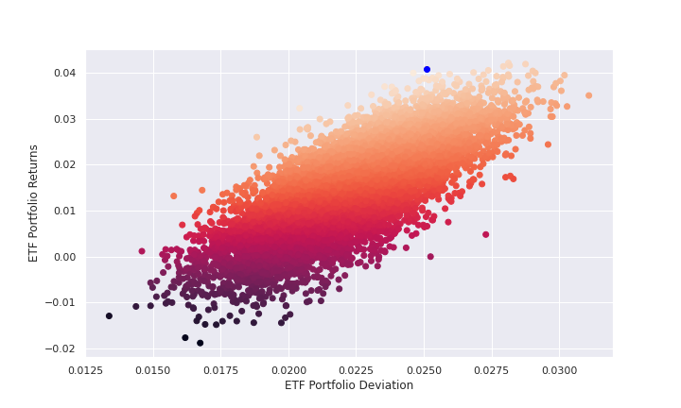
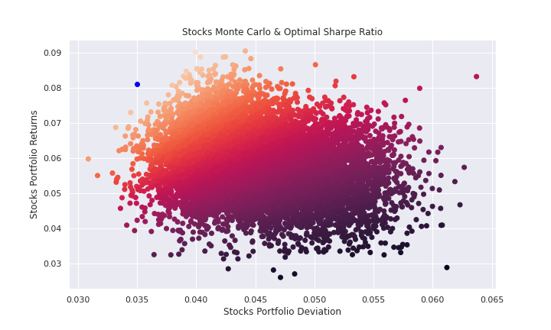
Results: Portfolio Optimization
ETFs suggest that a high risk brings a high reward at lower rates of risk & return, BUT…
…. Stocks during market disruptions suggest that reducing your risk will generally produce higher returns at higher rates of risk & returns (interesting!)
*Blue dot represents the Sharpe Ratio
Notes:
Speaker: Lee

Slide 12
Results: Hypothesis Testing
During market disruptions, we found no statistically significant difference in the mean returns of stocks & ETFs
Notes:
Speaker: Sean
During periods of market disruption there is no statistically significant difference in the mean returns of Stock vs ETFs. Expanding on this idea from our exploratory data analysis, the traditional held belief that ETFs will provide a lower return at lower risk does hold true but during market disruptions they perform similarly to stocks. This could be surprising at first but illustrates how even the most resilient ETFs are not immune to the shock of world events on the markets

Slide 13
Conclusions & Future Outlook
During market disruptions ETFs are not immune to higher volatility, but more research is needed to determine why.
For Portfolio Optimization, ETFs included in this project favor higher risk/higher returns ratios but with generally smaller risk/return values over stocks; conversely, Stocks included in this project favor less risk/higher return ratios but with generally more risk/return values over ETFs.
Expand the data to look at random samples of stocks and ETFs, expanding the breadth and eliminating bias in our dataset
Notes:
Speaker: Sean & Lee
ETFs are only growing more popular by the day as they provide a convent off the shelf package for investors to instantly diversify their portfolios. This convince comes at a cost where the investor has to just accept that the ETF provider is calling the shots on what assets are in the ETF itself.
Common belief is that ETFs provide lower returns but are generally less risky investment than stocks dues to their lower volatility. Our project illustrates this fact ETFs had higher average closing prices but appeared to have lower returns. Plotting the returns of both stocks and ETFs we saw that ETFs had a lower amplitude. When we tested this hypothesis we found that, at least during periods of market disruptions, there was no difference in average returns between Stocks and ETFs. This could be surprising at first, but illustrates how even the most resilient ETFs are not immune to wold events and disruptions.

Slide 14
Technology Stack
Languages: Python
Tools/IDE: Google Collab
Libraries: Pandas, Matplotlib, Numpy, Scipy, Seaborn, Requests

Slide 15

Thank you for your time!

